Slide 1
RMNSUG
NetSuite Saved Search Tips & Tricks

Slide 2
Assumptions
  You have some familiarity with creating/modifying saved searches
  You will be able to download copies of this slide show and Tips & Tricks document with samples and details from RMNSUG
  For today, I want to show you that cool tools and capabilities exist so you can start dreaming of how to incorporate them into your own searches (no test at the end of the session ☺)
  Feel free to reach out if you have questions after today’s session
  Cory had two hours for his session; I only have 15 minutes, so let’s get started! ☺
NS/MF

Slide 3
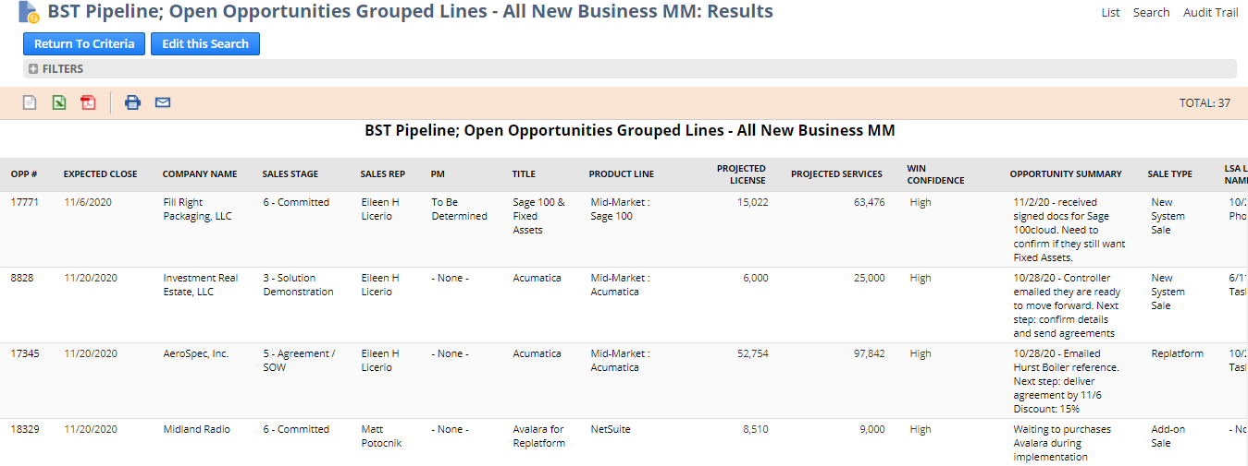
Building Blocks - It’s Mostly About Formulas in Results Columns
  Case statements to create columns for different types of result
NS/MF

Slide 4
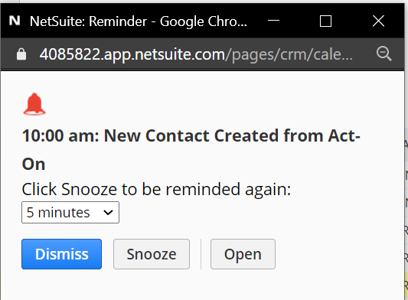
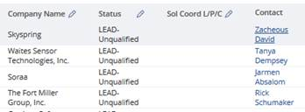
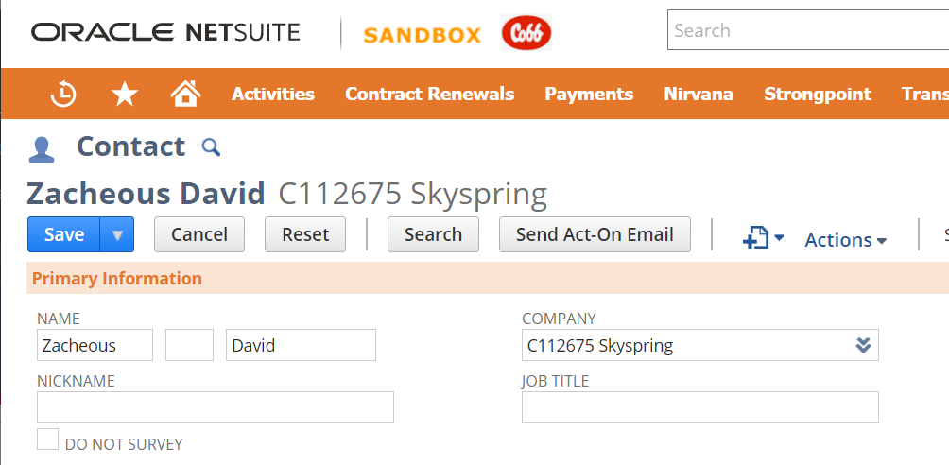
Building Blocks - It’s Mostly About Formulas in Results Columns
  Clickable links that allow quick access to the result
NS/MF

Slide 5
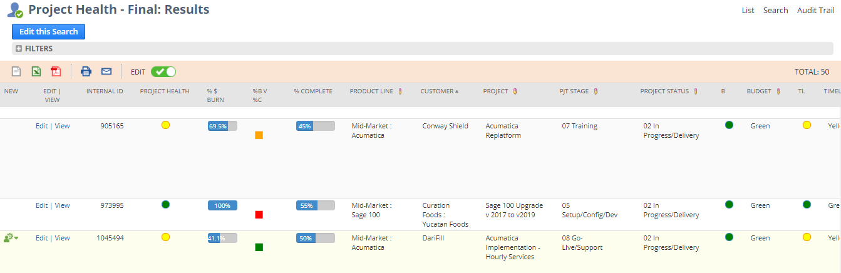
Building Blocks - It’s Mostly About Formulas in Results Columns
  Case statements to create columns for different types of result
NS/MF

Slide 6
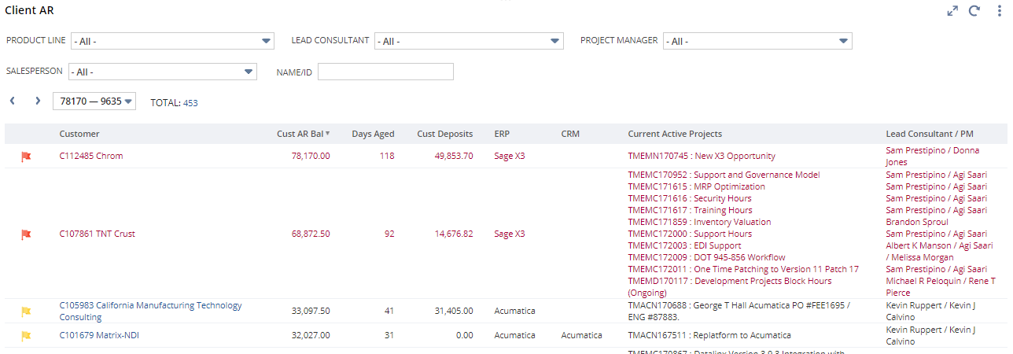
Building Blocks - It’s Mostly About Formulas in Results Columns
  LISTAGG function within summarized rows shows detail
NS/MF

Slide 7
Questions and Thoughts
Rick Cobb | NetSuite Administrator | Solution Architect
O: 949.583.9500 x1341 | C: 303.589.8598
rcobb@blytheco.com | www.blytheco.com
Blytheco | Transforming Companies

