Slide 1


Potpourri
Afternoon:
NetSuite Mobile App
Simple Workflow Example (Changing transaction form based on Customer)
Trigger Based Saved Search
Mass Updates
CSV Import
Multi-Currency
Pricing

Slide 2


Mobile Access
Setup within NS
Install Mobile App
Use Mobile App

Slide 3

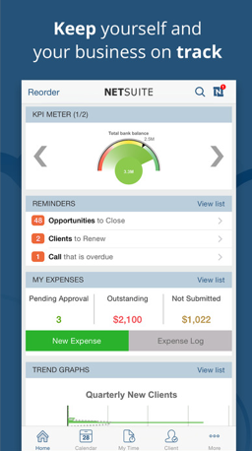
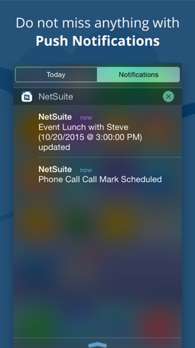
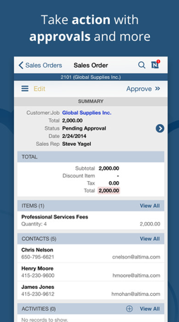
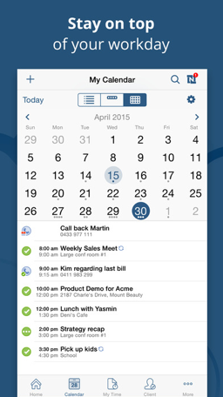
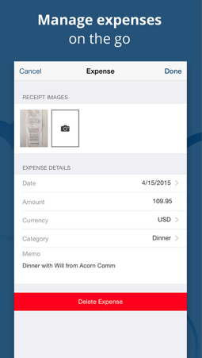
Value of NS Mobile App
Android Only - Offline Features – enable offline expense and time capture.
Log inbound (ONLY Android) and outbound phone calls (both), and assign them to companies and customers.

Slide 4
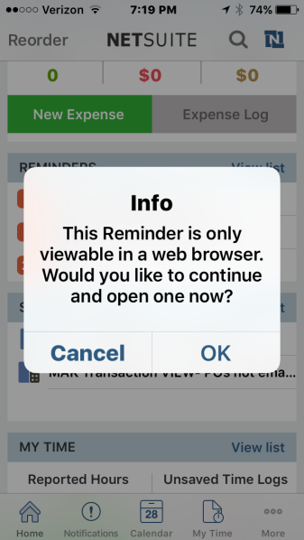
Records Supported
Entities: Contact, Customer, Employee, Lead, Partner, Prospect, Vendor
Transactions: Bills (vendor), Deposit, Estimate, Expense Report, Invoice, Purchase Order, Opportunity, Requisition, Return Authorization, Sales Order, Cash Sale, Customer Deposit, Item Fulfillment, Payment
CRM/Activities: Case, Event, Issue, Message, Phone Call, Task, User Note
Other: Custom Records, Item, Media Item (Files attachment), Time Entry
Note: not all reminders are not supported (e.g POs to bill, Orders to Fulfill, Memorized transactions due, Bills to pay, Orders to receive, Invoices Overdue, WO to Build, Customers to Bill)

Slide 5
Value of NS Mobile App
View on phone without needing a magnifying glass
Manage expenses and attach copies of receipts while out of the office
Create and submit expense reports for accounting approval.
Log and manage billable time effectively and instantly in and out of the office.
View your NetSuite dashboard
View calendar activities, accept or decline events, and mark tasks as complete.
Search for, view and edit records including contacts, customers, employees, cases, issues, leads, opportunities, prospects, estimates, and sales orders.
Android Only - Offline Features – enable offline expense and time capture.
Log inbound (ONLY Android) and outbound phone calls (both), and assign them to companies and customers.

Slide 6


System Requirements
iPhone /iPad
Android
Apple IOS7.x or higher
About 8MB
RAM is not indicated
Android 5.0 (Lollipop) or greater
Minimum screen resolution 800x480
Minimum 1GB RAM
Communication is compressed and encrypted.
On average, the app consumes less than 10MB of data per month.

Slide 7
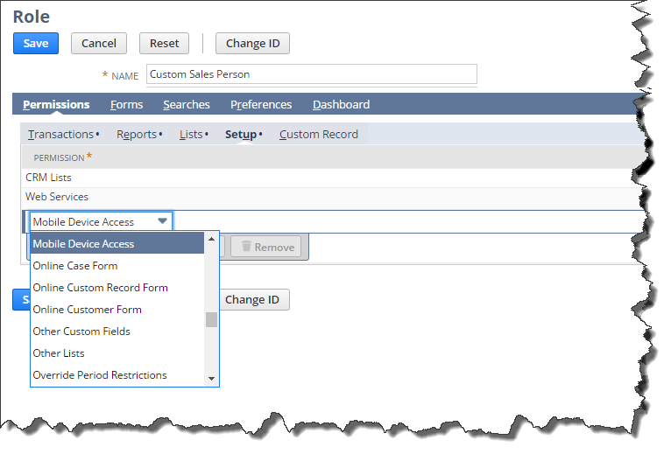
Setup in NetSuite
Modify Roles to add Mobile Access
Setup → Users/Roles→ Manage Roles > Permissions tab > Setup subtab
Select “Mobile Device Access”
Add
Save

Slide 8
Setup in NetSuite
Administrators & Global Permissions
To add mobile access for NS administrators or to add it for all roles for an employee:
Enable global permissions if not already setup
  Setup → Company → Enable Features > Employees tab
  Check Global Permissions
  Go to employee record and add “Mobile Device Access” to the global permissions

Slide 9
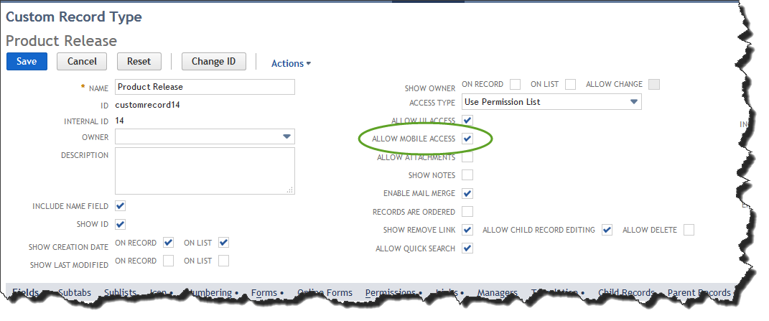
Setup NetSuite For Custom Records
Allow Mobile Access must be checked in order to see custom record on phone

Slide 10
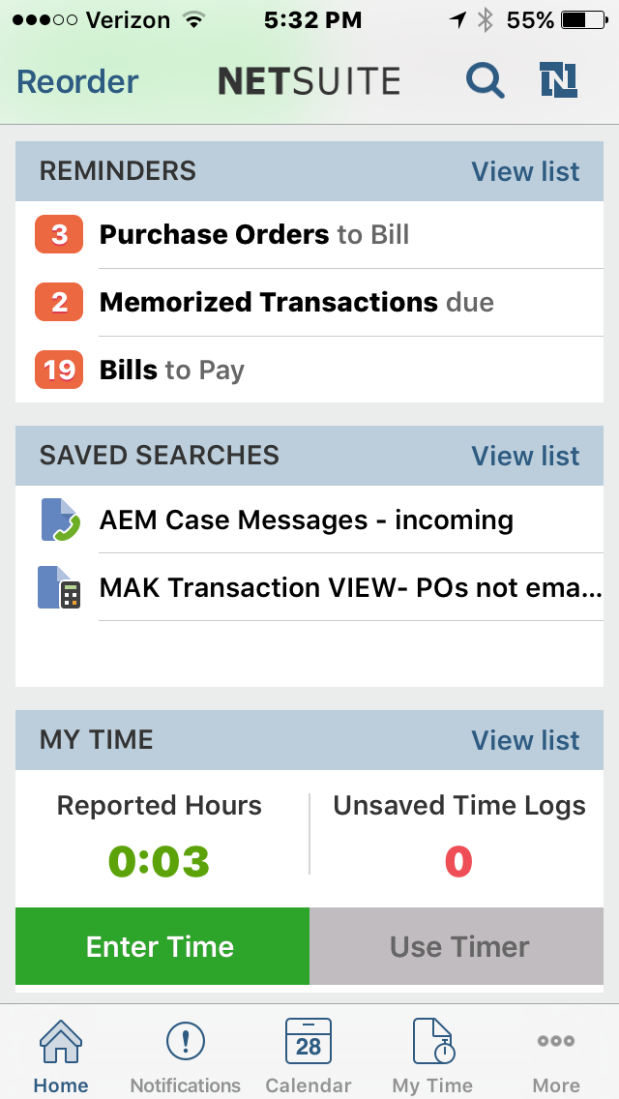
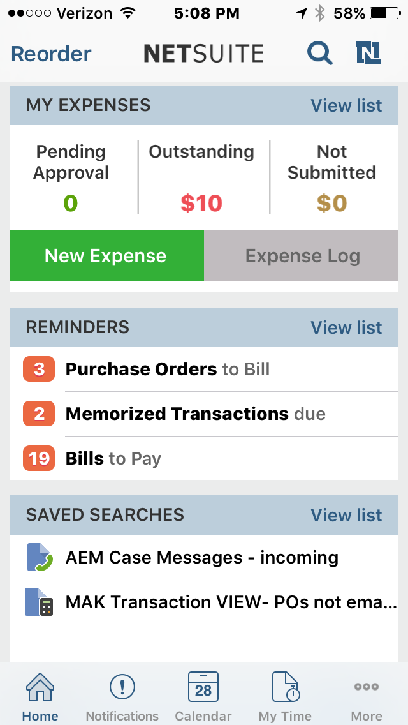
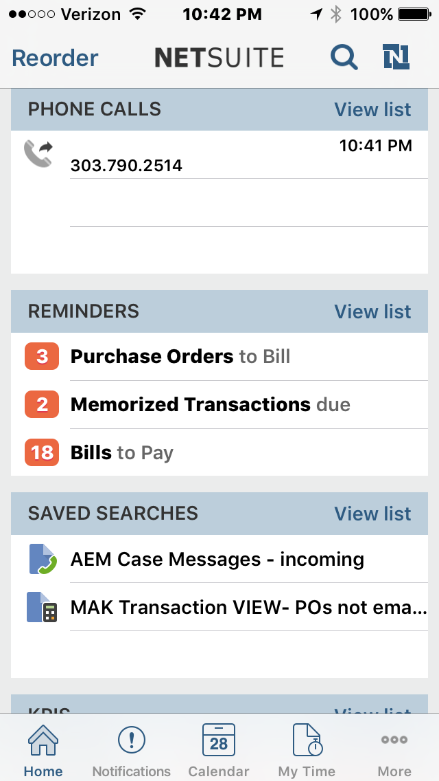
Mobile App – Home Page
Notes:
Reorder has animation
1st show one way to reorder
Then show another way – want to show logging of time

Slide 11
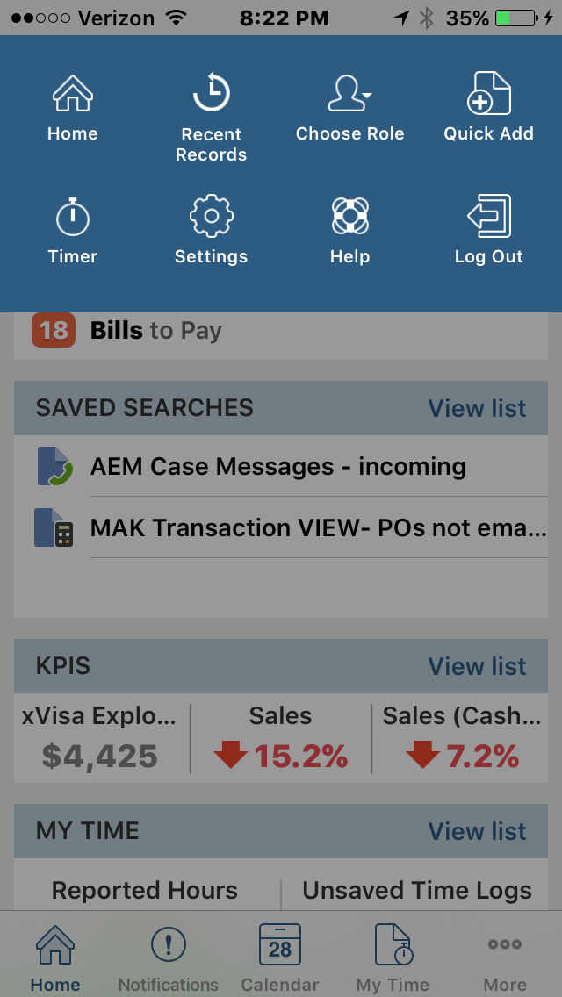
Mobile App – Home Page
Global Actions

Slide 12
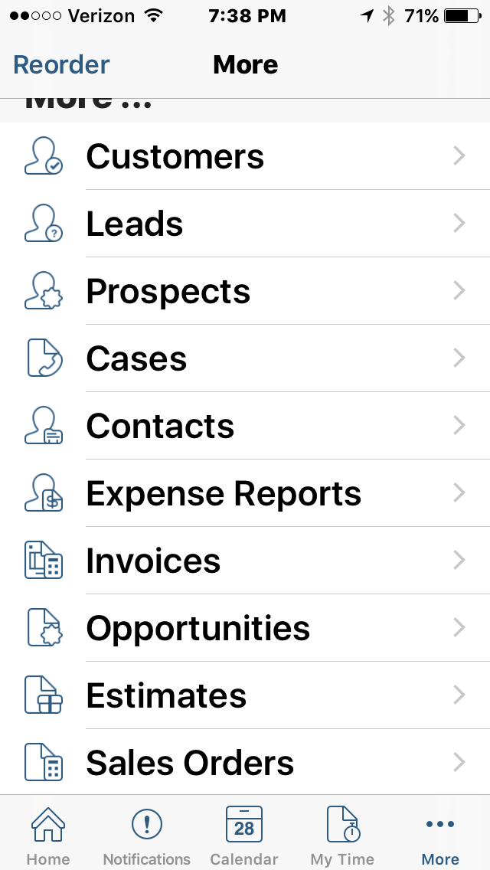
Mobile App – Home Page
More

Slide 13
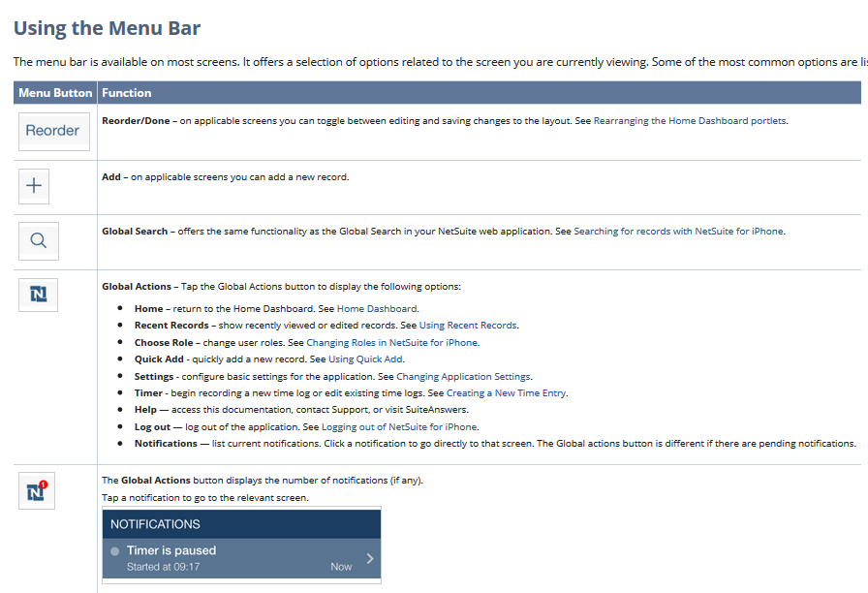

Slide 14

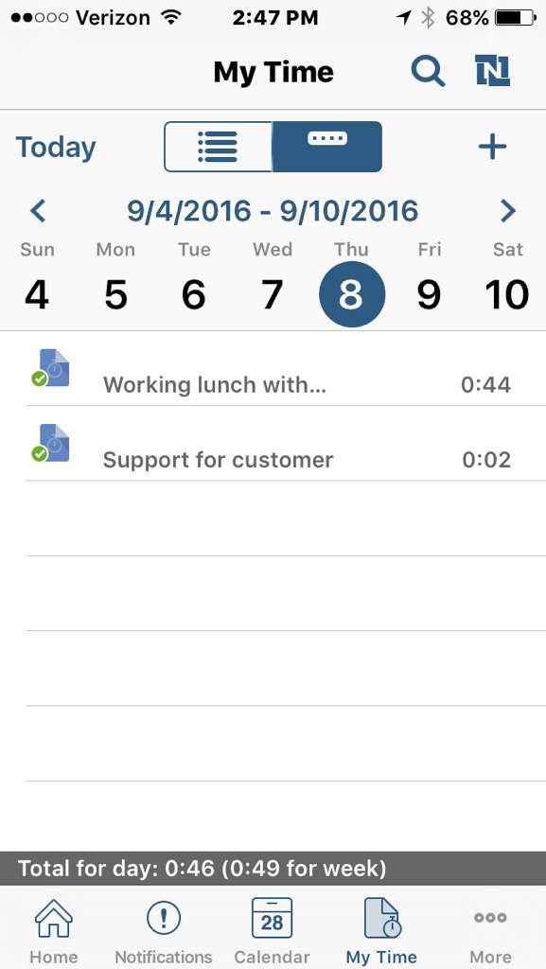
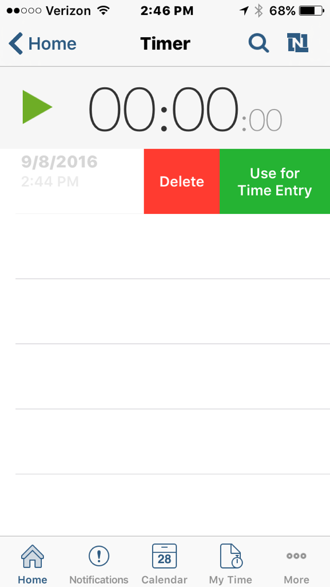
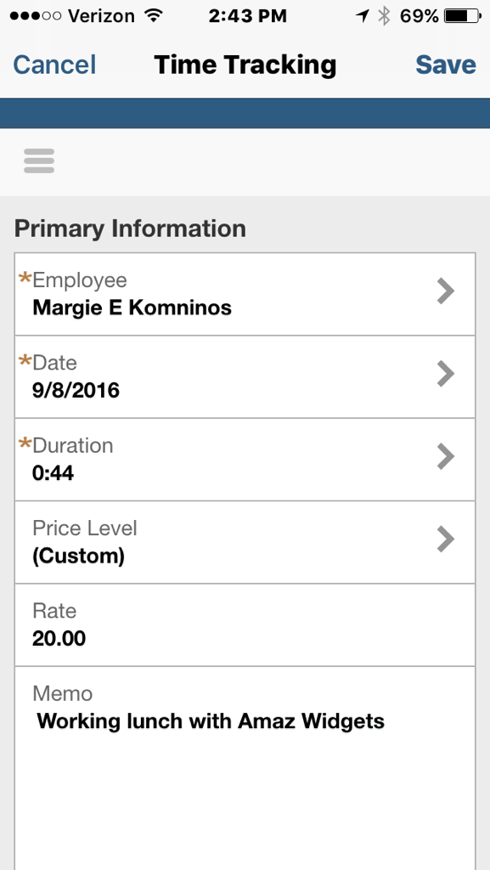
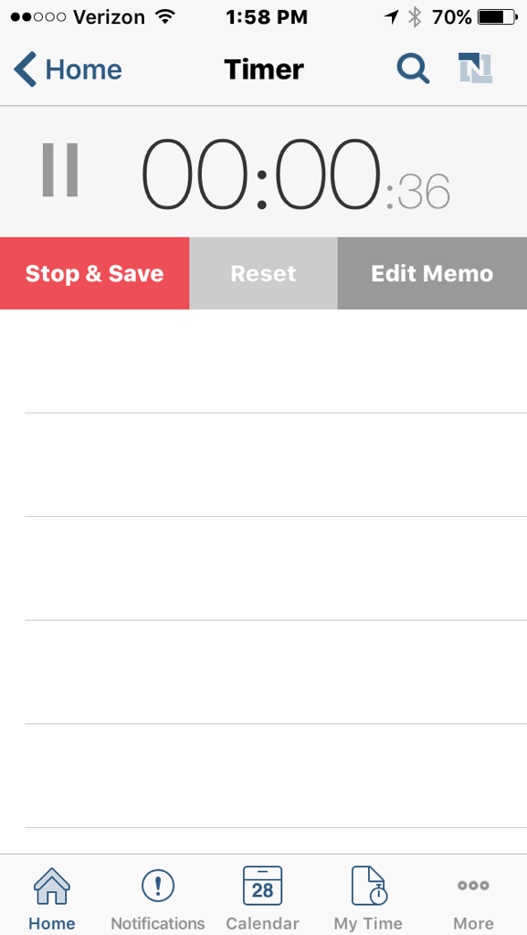
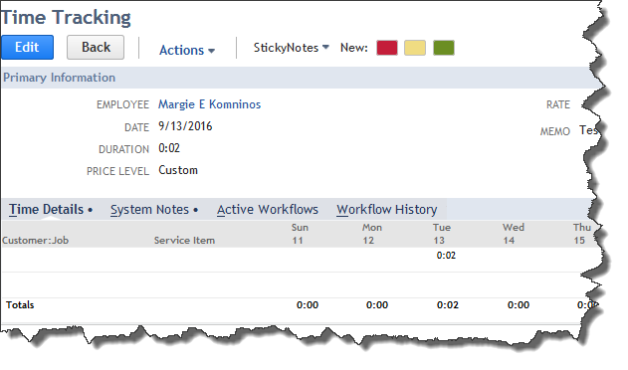
Logging Time
Notes:
4 steps
User Timer or Enter Time directly
Stop & Save
Use for Time Entry
Time Tracking Screen → Save
Review “My Time”
Then you can see it in NS

Slide 15
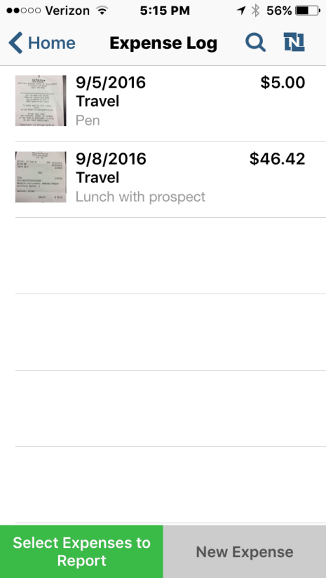
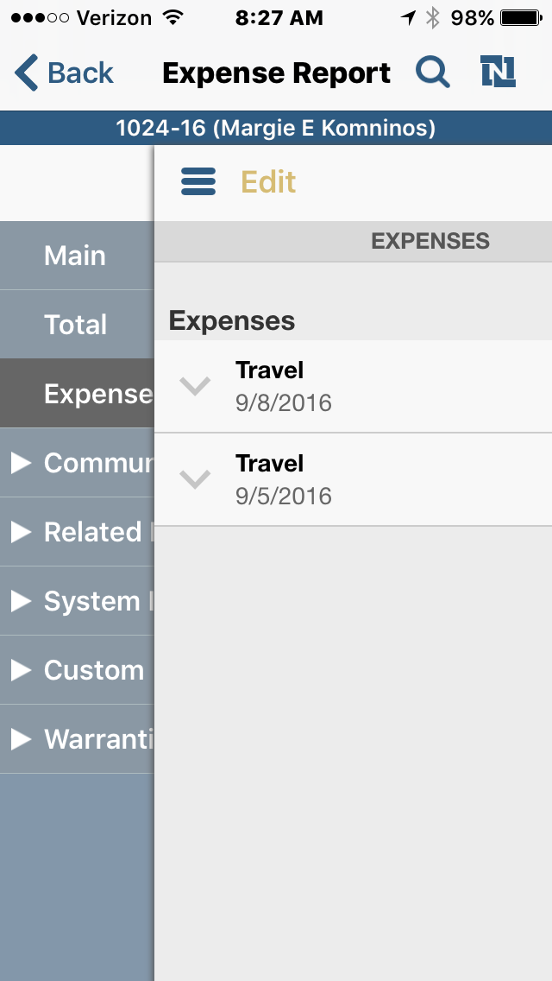
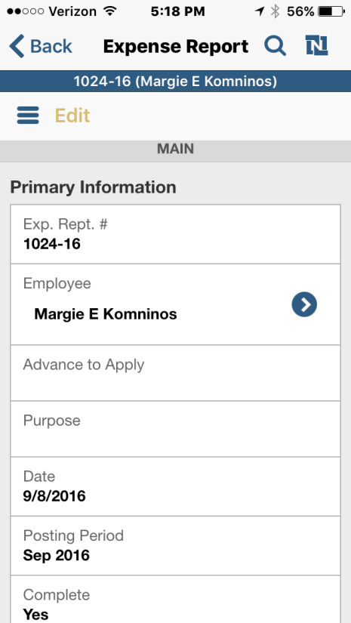
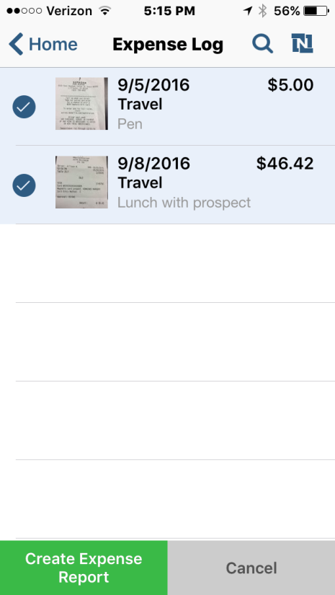

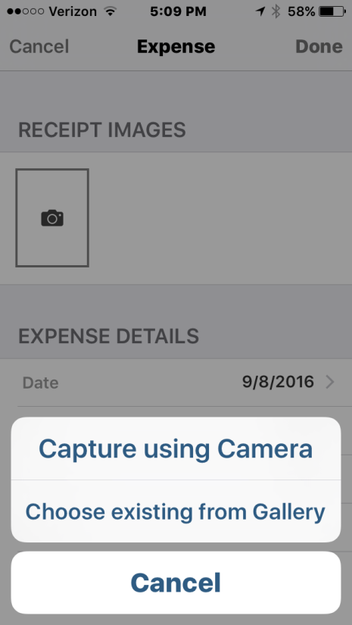
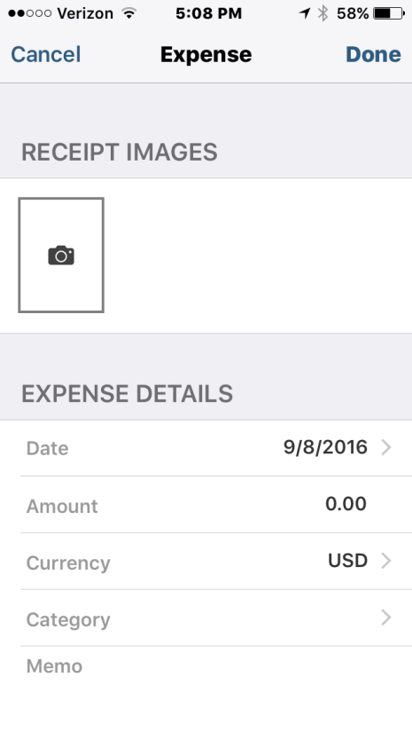
Entering Expenses
Notes:
Enter New Expense
Enter details
Take photo of expense and enter info
See expense log to report on
Select expenses
Create expense report
Can add detail with a swipe

Slide 16
2016.2 Updates
A new home dashboard, My Approvals, provides an at-a-glance reminder of items requiring your attention.
Users can approve and request approvals for expense reports and purchase orders directly from within the app
Tapping the dashboard takes you to a detail screen where items can be approved or rejected. Multiple items can be selected at one time.

Slide 17
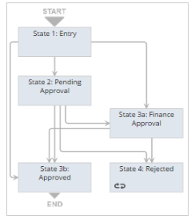
Simple Workflow
Change SO Based on Customer
Value Proposition:
DBA – different company names
Partners/Distributors want different information
Different requirements based on type of customer
Need different fulfillment page, PO, WO, packing slip, invoice

Slide 18
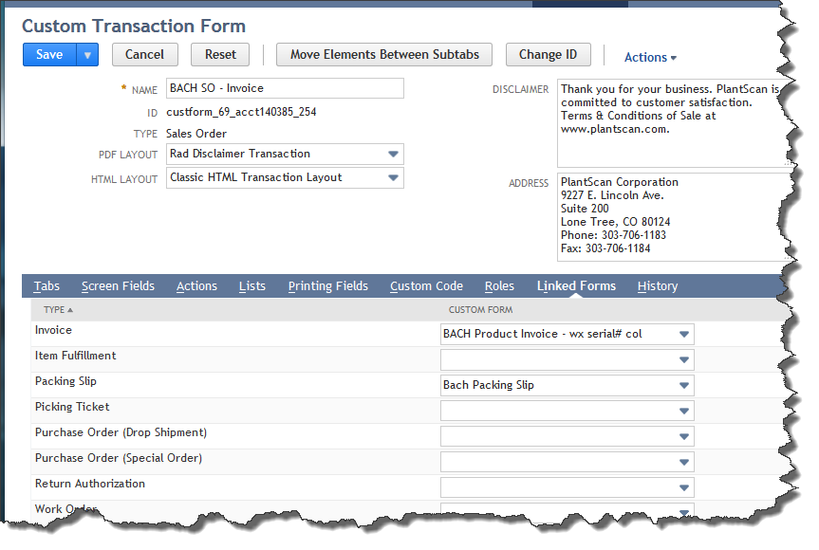
From Transaction Form
Linked Forms tab

Slide 19
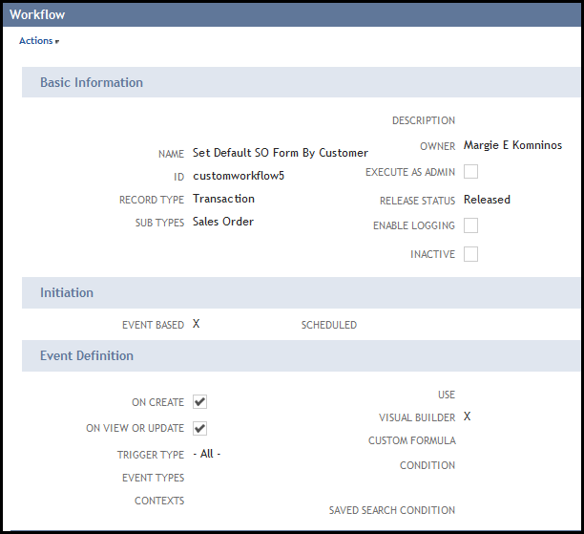
Simple Workflow
Change SO Based on Customer

Slide 20
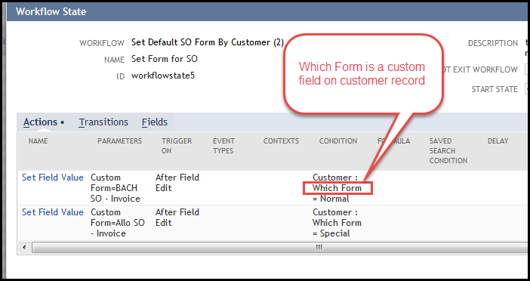
Simple Workflow
Change SO Based on Customer

Slide 21
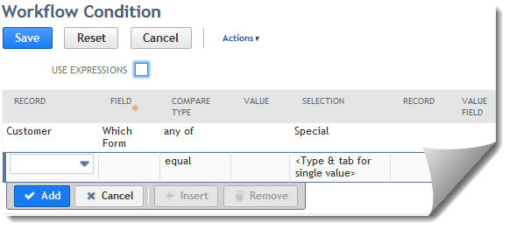
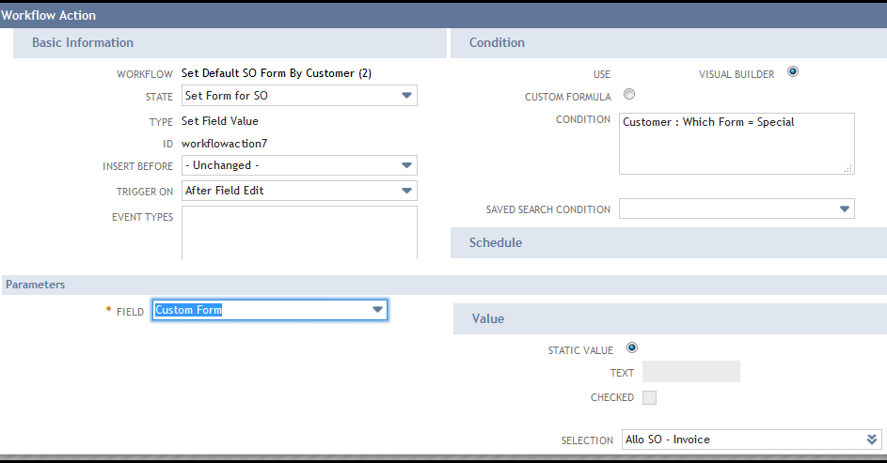
Simple Workflow
Change SO Based on Customer
Form selected from drop down – from Transaction Forms
Internal id of the Custom Form field

Slide 22
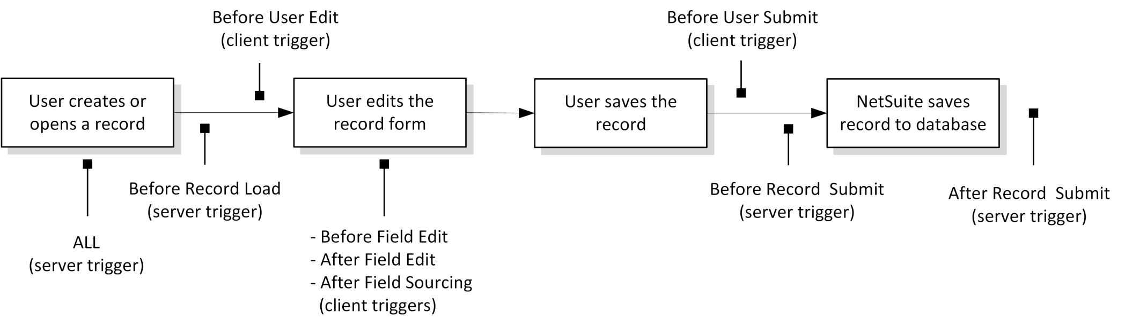
Workflow Triggers

Slide 23
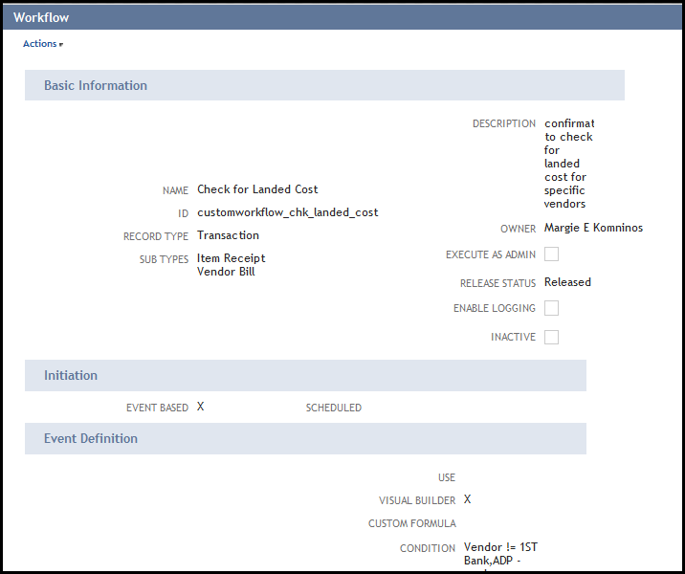
Simple Workflow
Confirm Landed Cost

Slide 24
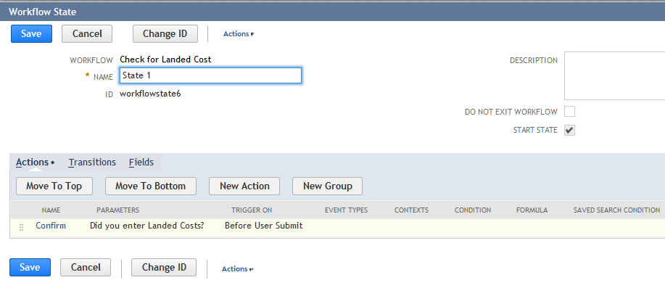
Simple Workflow
Confirm Landed Cost

Slide 25
Simple Workflow
Confirm Landed Cost

