Slide 1
Electronic Payments
Matt Hendricks

Slide 2
Bundle Information
Generation of payment files and direct debits using each bank's predefined file format
Support for standard bank payment formats
Ability to create your own custom payment formats
Automated creation of payment batches for approved bills
Scheduled automatic approvals of payment batches
Processing of multiple payment batches at the same time
Additional payment processing capabilities such as full reversal, partial reversal, and reprocessing
Support for multi-currency conversions that make it easier to pay suppliers across the globe in a single payment run using a single bank account
Generation of Positive Pay file formats containing details of checks issued irrespective of how they were produced
Ability to select transactions approved for payment using different combinations of filters
Bundle Name: NetSuite Electronic Payments
Bundle ID: 45178
Location: Production
Availability: Public
Source Account: 3778273

Slide 3
Configuration Steps
Work with your bank and make sure they accept the file formats
  AHC - CCD / PPD and AHC - CTX
Configure Company Bank accounts
Configure Vendor/Customer/Employee Bank details
Configure Approval routing if needed

Slide 4
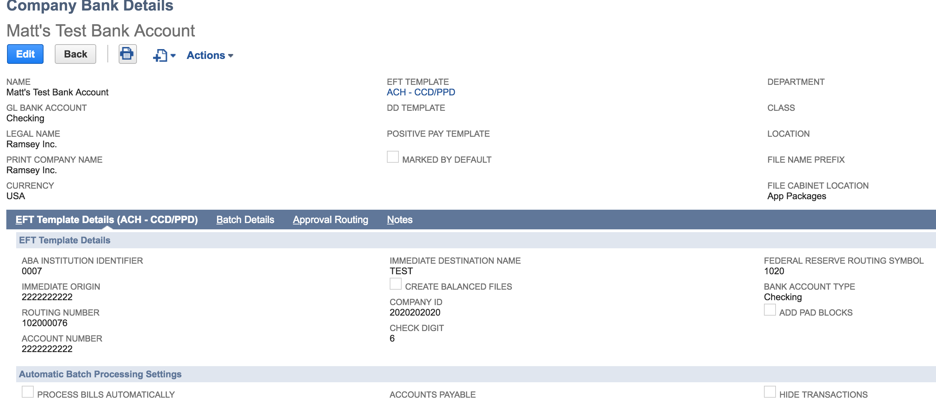
Company Bank Details

Slide 5
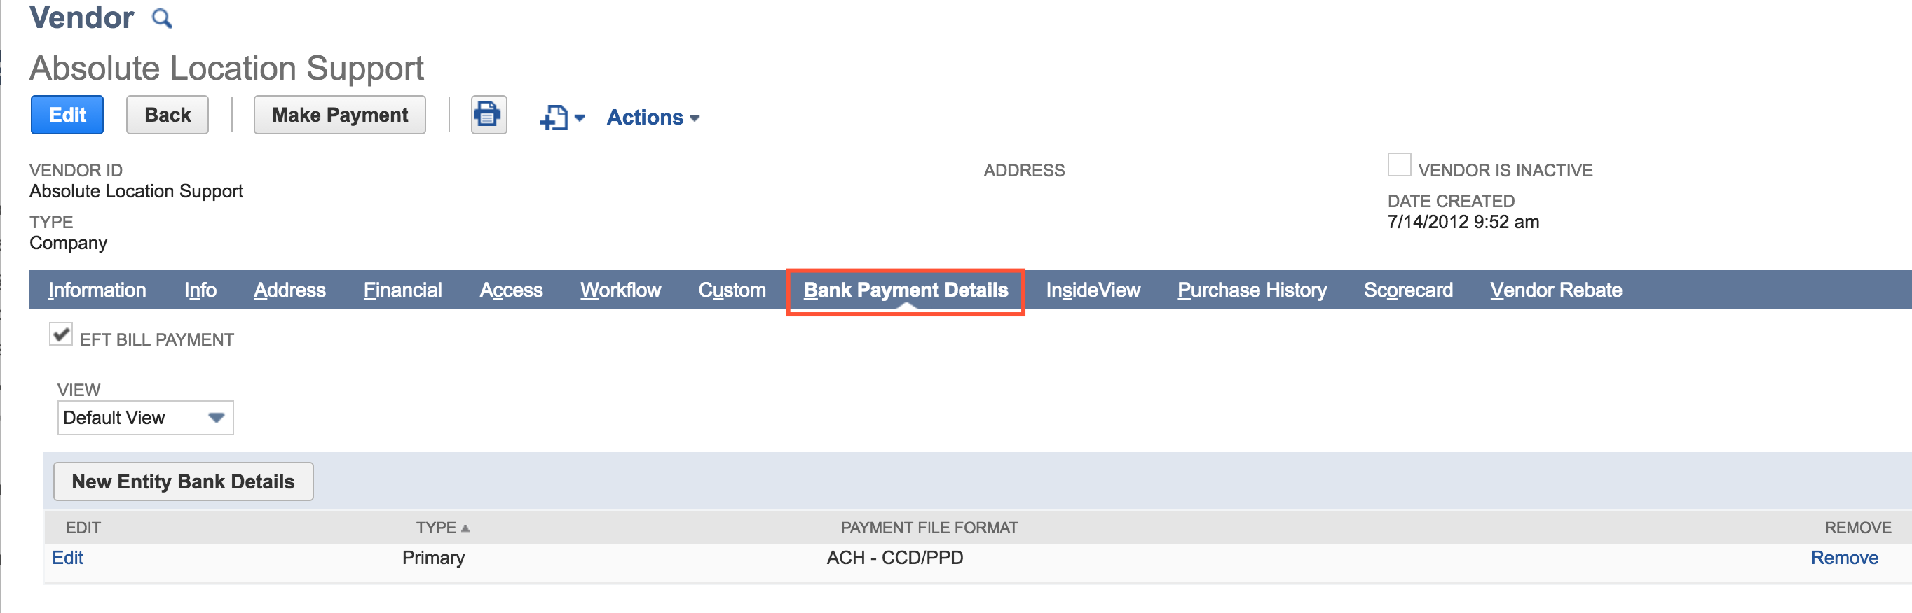
Entity Bank Details

Slide 6
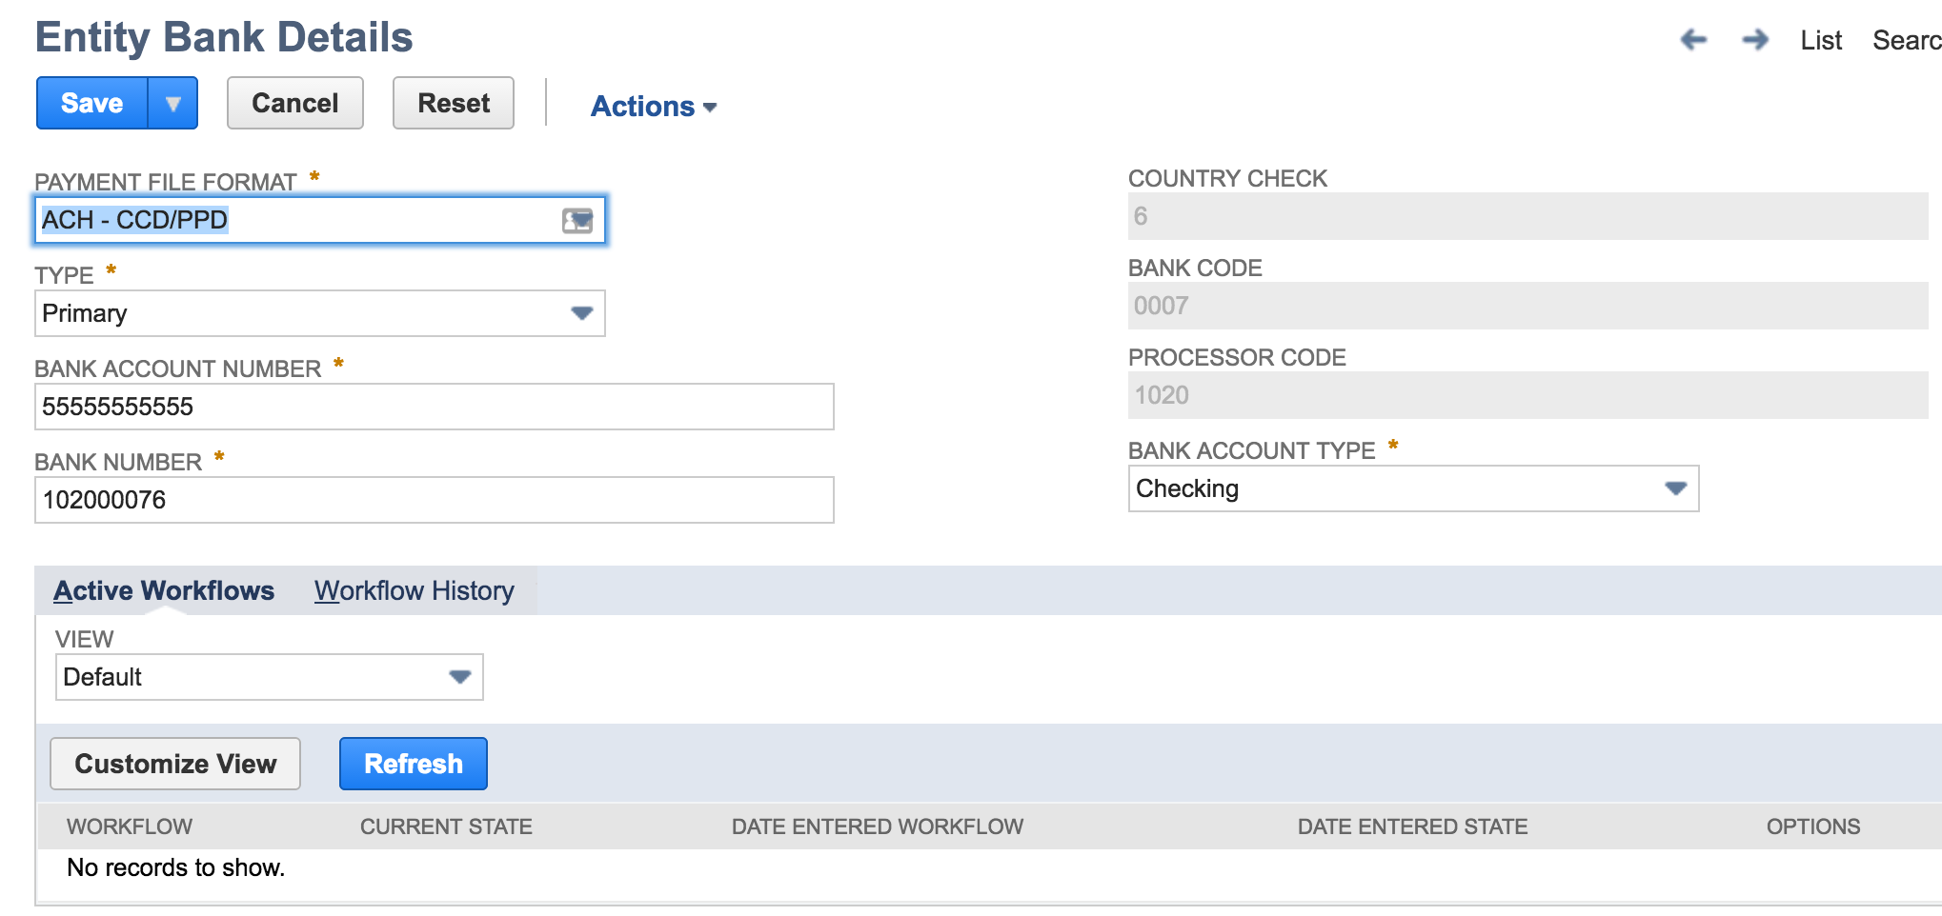
Entity Bank Details
Note: Must match the format of your Company Bank Details

Slide 7
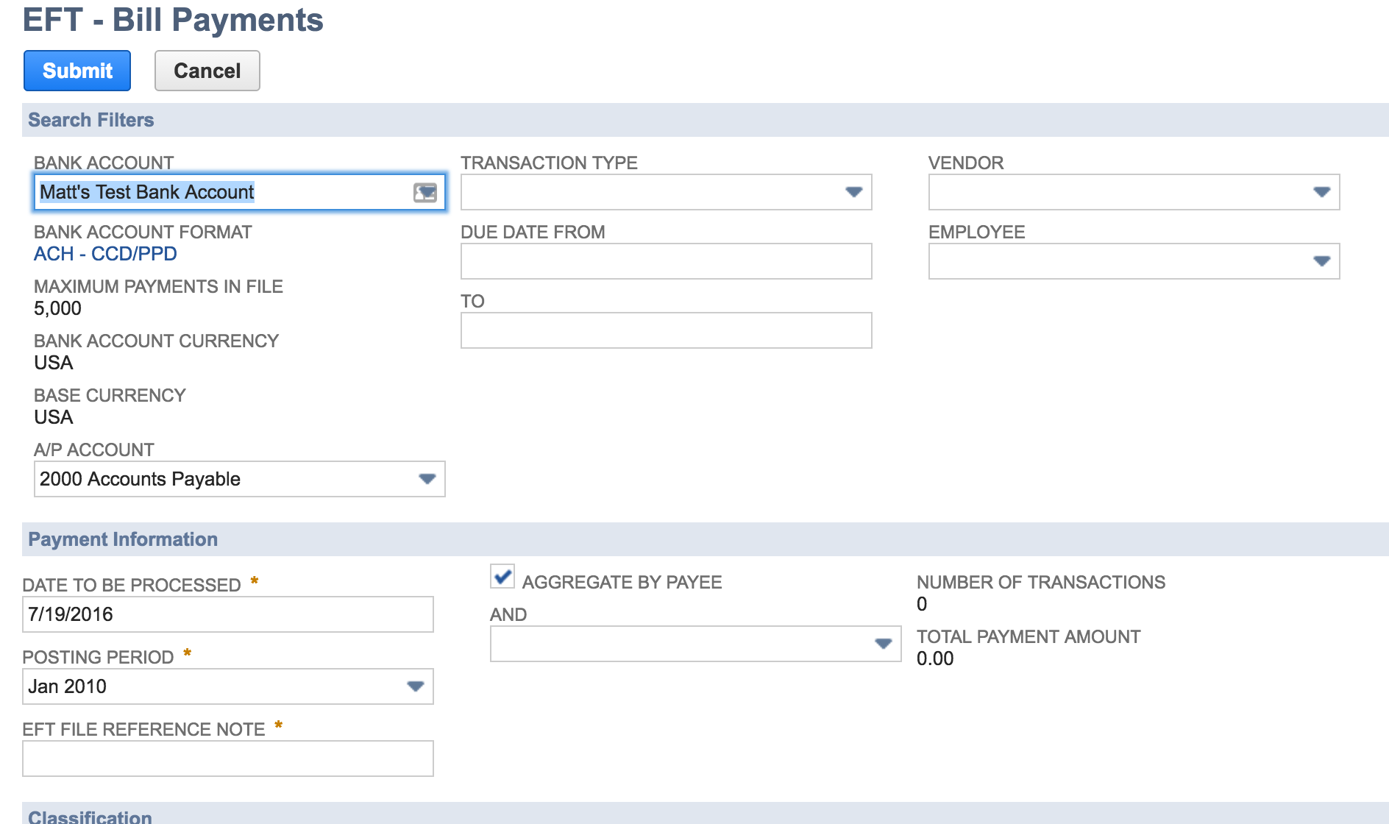
Payment Processing
Payments>Payment Processing>Bill Payment Processing
This page lets you generate payment records for your open invoices and initiates the script that generates the file.

Slide 8
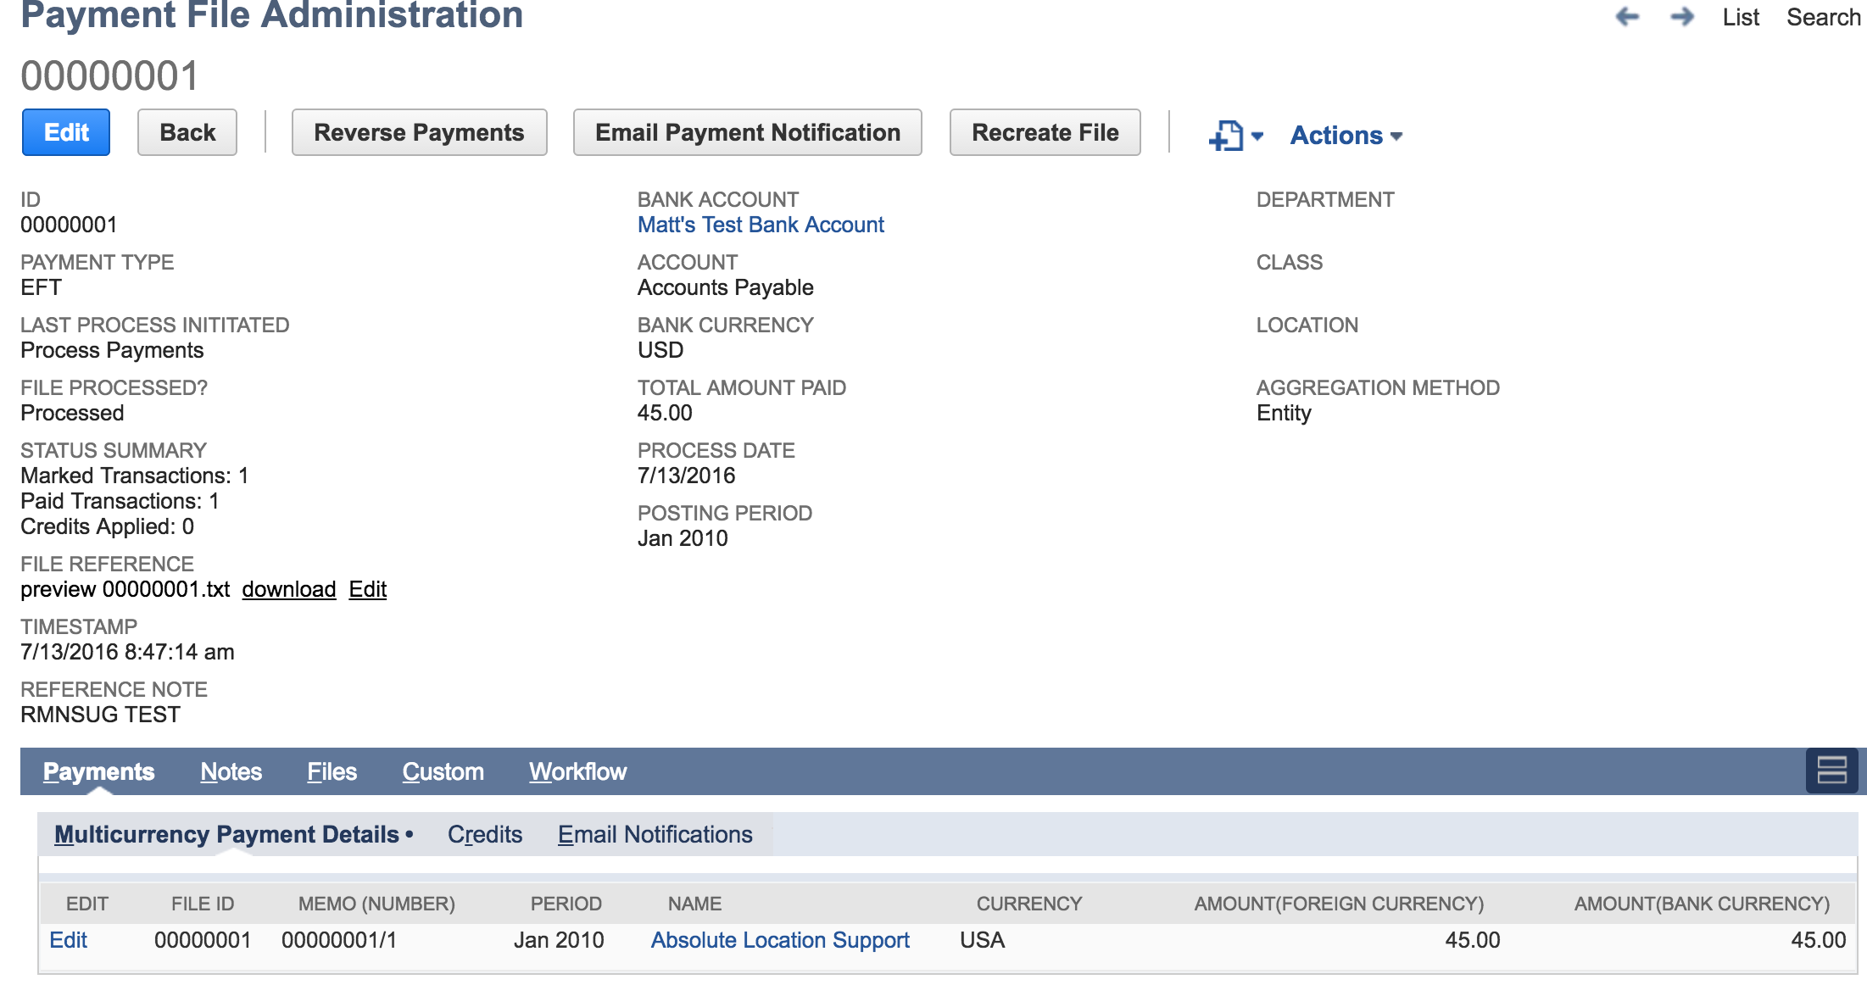
Payment File Administration
Once finished you can look for your payment file in the file cabinet folder.
Or in Payments>payment processing>Payment file administration.

Slide 9
Bill Payments in Batches
Payment batches for a bank account are created when you enable the Process Bills Automatically option on the bank details of that account. All outstanding bills that match the company bank criteria are automatically added in to batches.

Slide 10
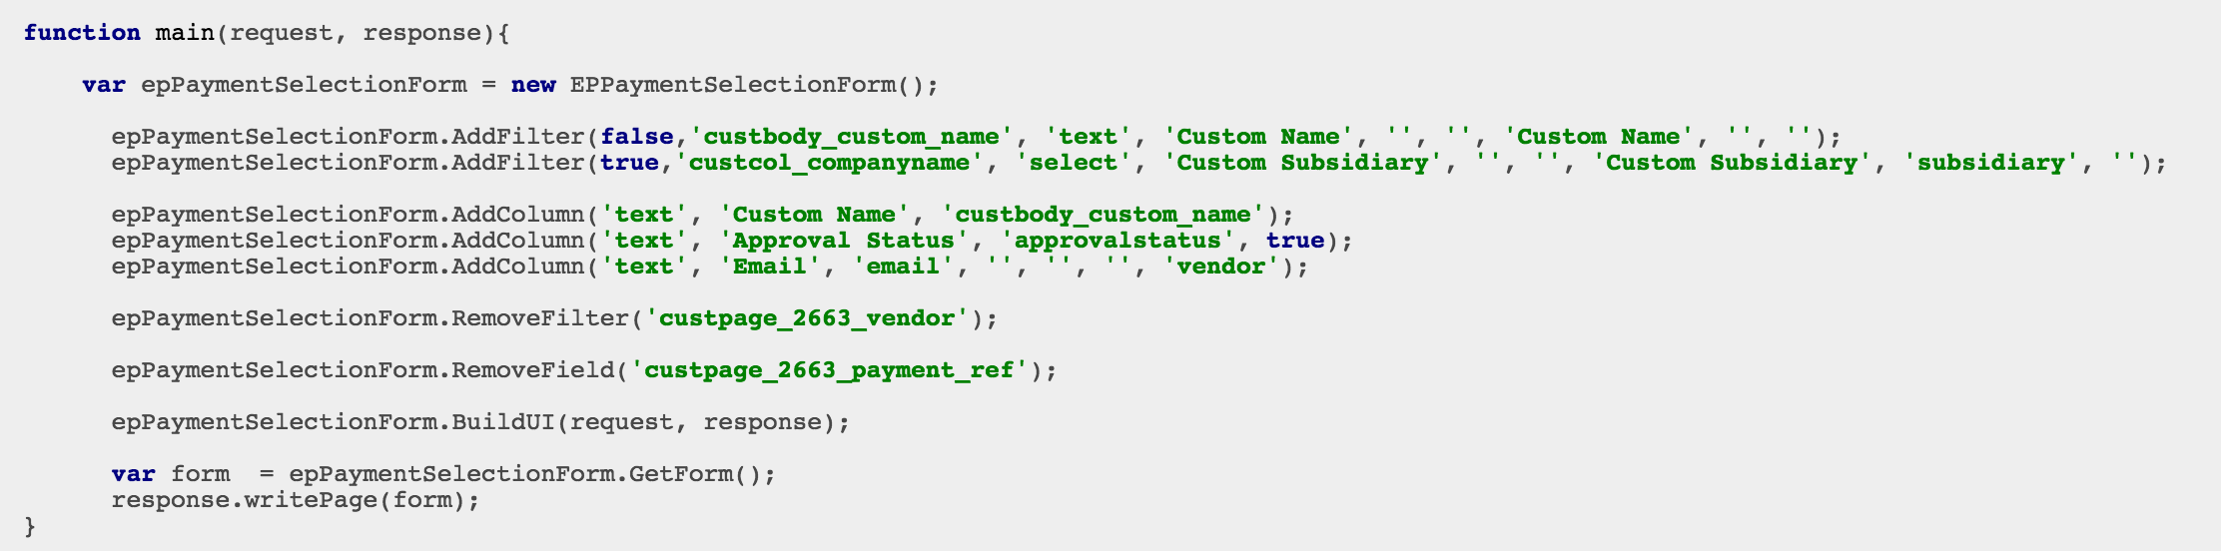
Electronic Payments API
Note: currently only supported by SuiteScript 1.0

Slide 11
Additional Features
Recreate files
Reverse Files
Email Payment Notifications
Schedule Payment Batches
Verify Issued Checks with Positive Pay

Slide 12
Questions?
Note: Full documentation of installation, setup and features with examples are all found in the NetSuite Help Center by typing “Electronic Payments”

